Slide 1

MoodTunes: A Mood-based Song Recommendation System
Purpose
Method and Results
Demonstration
Future Work
MoodTunes
Isabelle Rajendiran
Notes:
Hello, good morning, everyone and thank you for your time. Today, I will be presenting MoodTunes: a mood-based song recommendation system.

Slide 2
Agenda
01
Purpose
02
Method and Results
03
Demonstration
04
Future Work
Purpose
Method and Results
Demonstration
Future Work
What is the problem?
How does it work?
Streamlit application
Limitations and future work
MoodTunes
Isabelle Rajendiran
Notes:
I will start by proposing my idea and its purpose, followed by the method and results. I will have a quick demonstration of the app and end of the future work.

Slide 3

Music has this amazing way of connecting with your emotions.
Purpose
Method and Results
Demonstration
Future Work
I listen to music in all situations, but especially during times of heightened emotions e.g., stress, happiness, sadness, as a form of self-help for my emotional well-being.
My goal is to recommend songs based on the user’s emotion and thoughts.
Existing solutions rely on audio features, but not the lyrics for mood analysis.
MoodTunes
Isabelle Rajendiran
Notes:
Personally, I love listening to music, during all occasions. However, I find that I especially lean on it during times of heightened emotions such as when I’m happy and celebrating a success or stressed studying for an exam. I use it almost as a form of self-help for my emotional well-being.
This gave me the idea of creating a song recommendation system that recommends song based on the user’s emotion and thoughts as a way to help people express and process their emotions.
Existing solutions rely on a song’s audio features e.g., tempo and energy for mood analysis. However, I personally find that lyrics are more important for me to establish a greater emotional connection to a song. Therefore, here I aim to use a lyrics-based approach to determine meaningful song recommendations.

Slide 4
Key Steps
01
Data Collection and Cleaning
Purpose
Method and Results
Demonstration
Future Work
02
Emotion Detection
03
04
Similarity Matching
Topic Modelling
MoodTunes
Isabelle Rajendiran
Notes:
This project consisted of 4 main steps. I will go through these.

Slide 5


1. Data Collection and Cleaning
Purpose
Method and Results
Demonstration
Future Work
Data collected from Kaggle: 960K Spotify Songs With Lyrics data.
Song title
Album title
Artist(s)
Lyrics
Basic cleaning:
Remove duplicates
Remove null records
Remove whitespace, newlines, lowercase etc.,
Filtered out non-English songs.
Random sampling of the dataset to get only 10,000 songs.
Kaggle logo from Wikipedia
MoodTunes
Isabelle Rajendiran
Notes:
The data was sourced from Kaggle, which contained over 960,000 songs. From this, I kept the song title, album title, artist name and lyrics. I did some basic cleaning like removing duplicates. I also removed non-English songs. Due to the large size of the dataset, I randomly sampled 10,000 songs for computational efficiency.

Slide 6
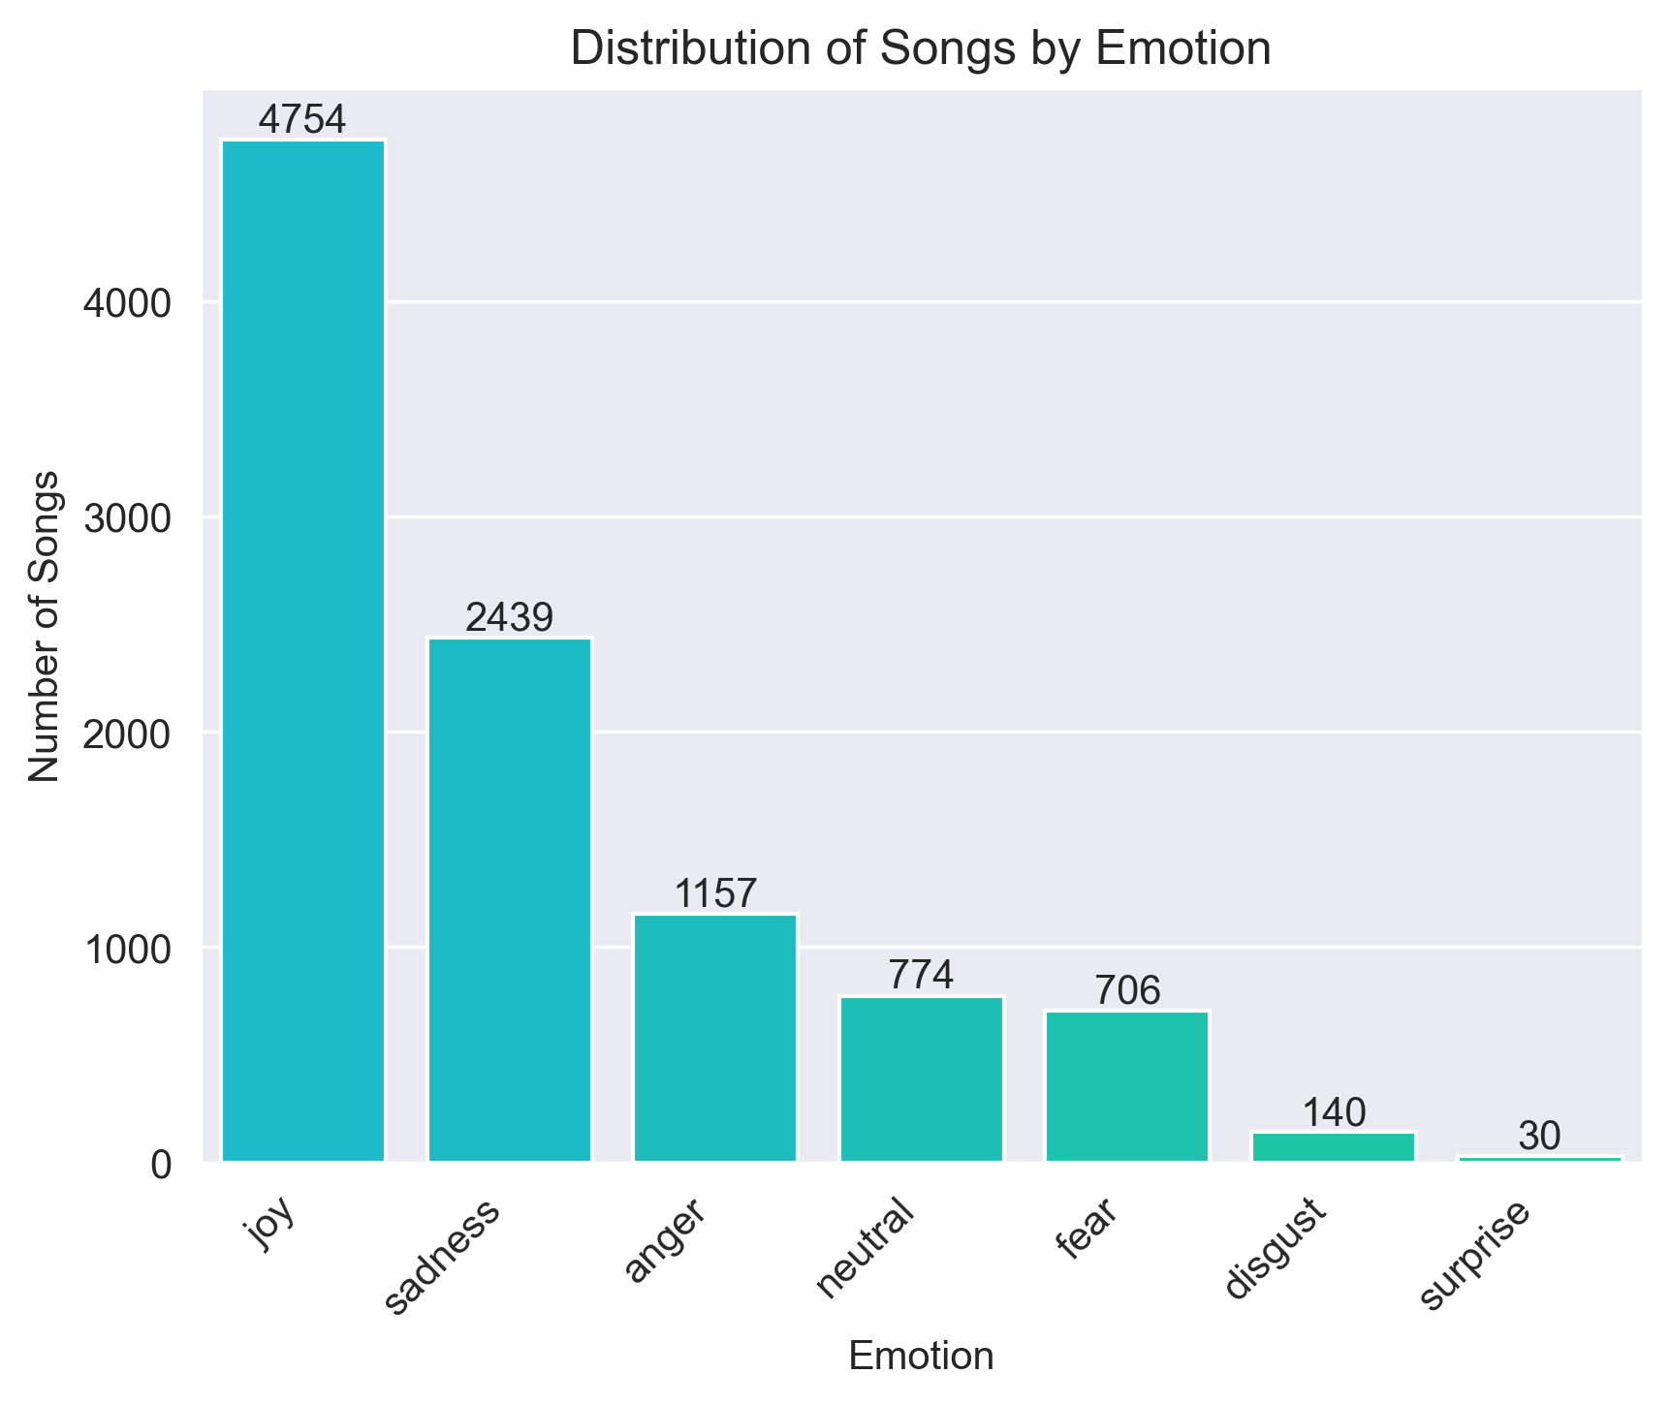
2. Emotion Detection
Purpose
Method and Results
Demonstration
Future Work
BERT (Bidirectional Encoder Representations from Transformers) – a deep learning model for natural language processing (NLP).
Michelle Jieli’s Emotion Text Classifer:
Fine-tuned on text from Twitter, Reddit, student reports and TV dialogues e.g., from Friends.
Detects 6 Ekman emotions (anger, disgust, fear, joy, sadness and surprise) and a neutral class.
Applied on my lyrics dataset:
Majority are joy (48%) and sadness (24%).
In line with the usage of my application.
MoodTunes
Isabelle Rajendiran
Notes:
Next, I had to retrieve the emotion from the lyrics for each song. For this, I used a pre-trained BERT model, a deep learning model for NLP.
This model, by Michelle Jieli, has been fine-tuned for emotion classification by training it on a variety of text including TV dialogues. It can predict 6 emotions as well as a neutral class.
I applied this model to my lyrics to assign an emotion for each song.
As you can see, almost half of the dataset were joyful songs, followed by 24% sad songs. While a balanced dataset would be ideal, this was almost expected as most songs tend to express emotions like happiness, sadness, or anger. From personal experience, these are also the emotions that most often drive people to listen to music and therefore I find it acceptable for the purpose of my mood-based song recommendation.
Well, how do I know that the model has been predicting accurately? Well, the only way really was manual human evaluation.

Slide 7


2. Emotion Detection
Purpose
Method and Results
Demonstration
Future Work
[Chorus]
And I don't know how it gets better than this You take my hand and drag me head first Fearless And I don't know why But with you I'd dance in a storm In my best dress Fearless
…
- Fearless by Taylor Swift
Predicted emotion: Joy
Left to decay in your hole forgotten
Lying down isolated and rotting
Worms drill through your guts so fresh
Puncturing the putrescent flesh
Inside the shell pathogens incubate
Microbial feast on flesh awaits
Stinking ooze of acidic compounds
Contamination spreads all around
Odious stench thickens and creeps...
Putrefaction juice slowly seeps...
- Ominous Seep of Putridity by Morbific
Predicted emotion: Disgust
It's what I want, hurry and buy All has been tried, follow reason and buy Cannot shuffle in this heat, it's all wrong Try to put that on your sleeve it's all wrong, it's all wrong He's got a pretty persuasion She's got pretty persuasion God damn, pure confusion She's got pretty persuasion
…
- Pretty Persuasion by R.E.M
Predicted emotion: Disgust
MoodTunes
Isabelle Rajendiran
Notes:
I randomly picked a couple of songs and checked their emotions.
For example, Fearless by Taylor swift was assigned as ‘joy’ and even just looking at the first line, “I don't know how it gets better than this”, I would say this is correctly identified. Overall, I found that the model was mostly good at predicting joy and sadness.
However, it struggled for less common emotions like ‘disgust’ and ‘surprise’. For example, this song repeats phrases like ‘it’s all wrong’ and ‘pure confusion’ which to me indicates frustration or confusion, rather than ‘disgust’. This shows a limitation of this model - it can only label 6 emotions which doesn't capture the full spectrum of human feelings.
I’m sure you’re all curious what a good ‘disgust’ song would look like so here’s an example of that too. I’ll give you some time to read that… Yep, so I think the model hit the nail on the head for that one.

Slide 8

3. Topic Modelling
Purpose
Method and Results
Demonstration
Future Work
Topic modelling is an unsupervised machine learning technique to find the hidden 'topics' within a set of documents (in this case, lyrics). A topic is a cluster of words that frequently occur together.
1. Data pre-processing
Removal of stop words, punctuation and meaningless words
Stemming to reduce words to their root form
Tokenisation into words
2. Feature extraction
TF-IDF (Term Frequency-Inverse Document Frequency) corpus
Captures meaningful words that define each song’s themes
3. Latent Dirichlet Allocation (LDA)
Probabilistic model that assumes each document is a mixture of topics and each topic is a distribution of words
Used coherence to choose the number of topics are there any strong topics?
MoodTunes
Isabelle Rajendiran
Notes:
Next, I needed to find the main themes of each song to be able to recommend relatable songs to the user.
For that, I used topic modelling, a technique which finds the hidden topics within a set of documents, in my case lyrics, where a topic consists of words that frequently appear together.
First, I conducted cleaning of my lyrics, including removal of stop words, punctuation and meaningless words. I then stemmed and tokenised the lyrics into words.
Next, I converted these tokens into numerical data using TF-IDF, which assigns a score to each token based on its importance in a lyric relative to the entire dataset. This helps highlight meaningful words that define a song’s themes rather than just frequent words.
Finally, I applied LDA, a topic modelling technique that assumes each document contains a mix of topics, such as love or heartbreak, and that each topic is represented by related words. LDA assigned probabilities to different topics within each lyric.
A challenging aspect of the LDA modelling was choosing the number of topics to find. For this, I tested models ranging from 2-20 topics and compared a metric called coherence, which basically measures how meaningful the generated topics are. I actually found that coherence scores were consistently low, suggesting that the lyrics may not have strong, distinct themes at all.

Slide 9
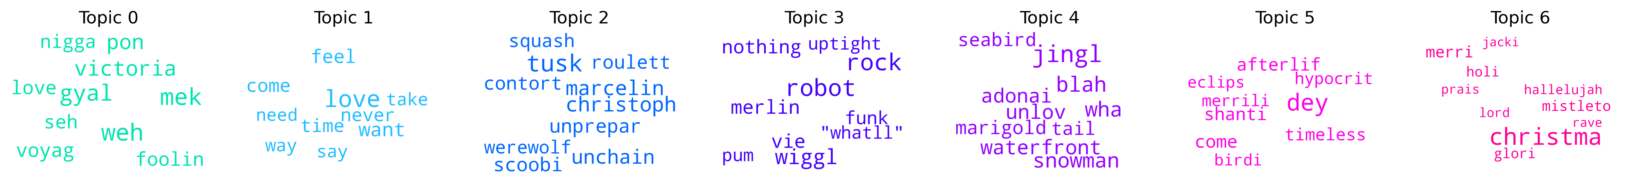
3. Topic Modelling
Purpose
Method and Results
Demonstration
Future Work
0: Caribbean-Inspired
Terms e.g., “weh” (where), “gyal” (girl), “pon” (on), suggest the use of Caribbean dialects.
1: Love & Relationships
Terms e.g., "love," "want," "feel," suggest a heavy focus on love, emotions and romance.
2: Abstract Imagery & Supernatural
References to supernatural themes ("werewolf"), and abstract imagery ("contort", "squash").
3: Funk, Rock & Groove
Terms e.g., "rock,", "funk", "wiggl" suggests a theme rooted in groove-based music as well as a futuristic theme ("robot“).
4: Winter & Nature-Inspired
Terms e.g., "jingl", "snowman" suggest winter while "waterfront", "seabird", and "marigold" hint at nature and peaceful settings.
5: Philosophical & Existential
Terms like "afterlife", "timeless", "eclipse", "hypocrite", might suggest a focus on reflection or spirituality.
6: Christmas & Religious
Terms e.g., "christma," "merri," "mistleto," "glori," "holi," "hallelujah," "lord," clearly represents Christmas and religious themes.
MoodTunes
Isabelle Rajendiran
Notes:
In the end, I ended up choosing 7 topics which by manually looking at the topics, felt the most coherent.
Here are the word clouds generated from the most common tokens for each topic.
Topic 0 has common Caribbean dialect words, indicating this topic is associated with reggae, dancehall, or Afro-Caribbean music.
Topic 1 has a heavy love and romance theme with words like ‘love’, ‘want’ and ‘feel’.
Topic 2 is more unusual and fragmented. There are some supernatural themes like ‘werewolves’ but also abstract imagery with words like ‘contort’ and ‘squash’.
Topic 3 has some groove-based terms like funk and wiggl, but also ‘robot’ which could indicate futuristic elements.
Topic 4 has winter terms like snowman and jingle but also nature terms like seabird and marigold. This topic could cover festive and relaxing songs.
Topic 5 is hard to find a theme for but terms like "afterlife“ and "hypocrite“ might suggest a focus on reflection/questioning or spirituality.
Topic 6 clearly represents Christmas with terms like ‘Christmas and merri’ but also religious themes with terms like ‘praise’, holy and lord.
This confirms what was indicated by the low coherence score of -13.5, as some topics are meaningful while others appear fragmented or noisy. Despite this, the topics do provide some insights into the lyrical content of my dataset.

Slide 10
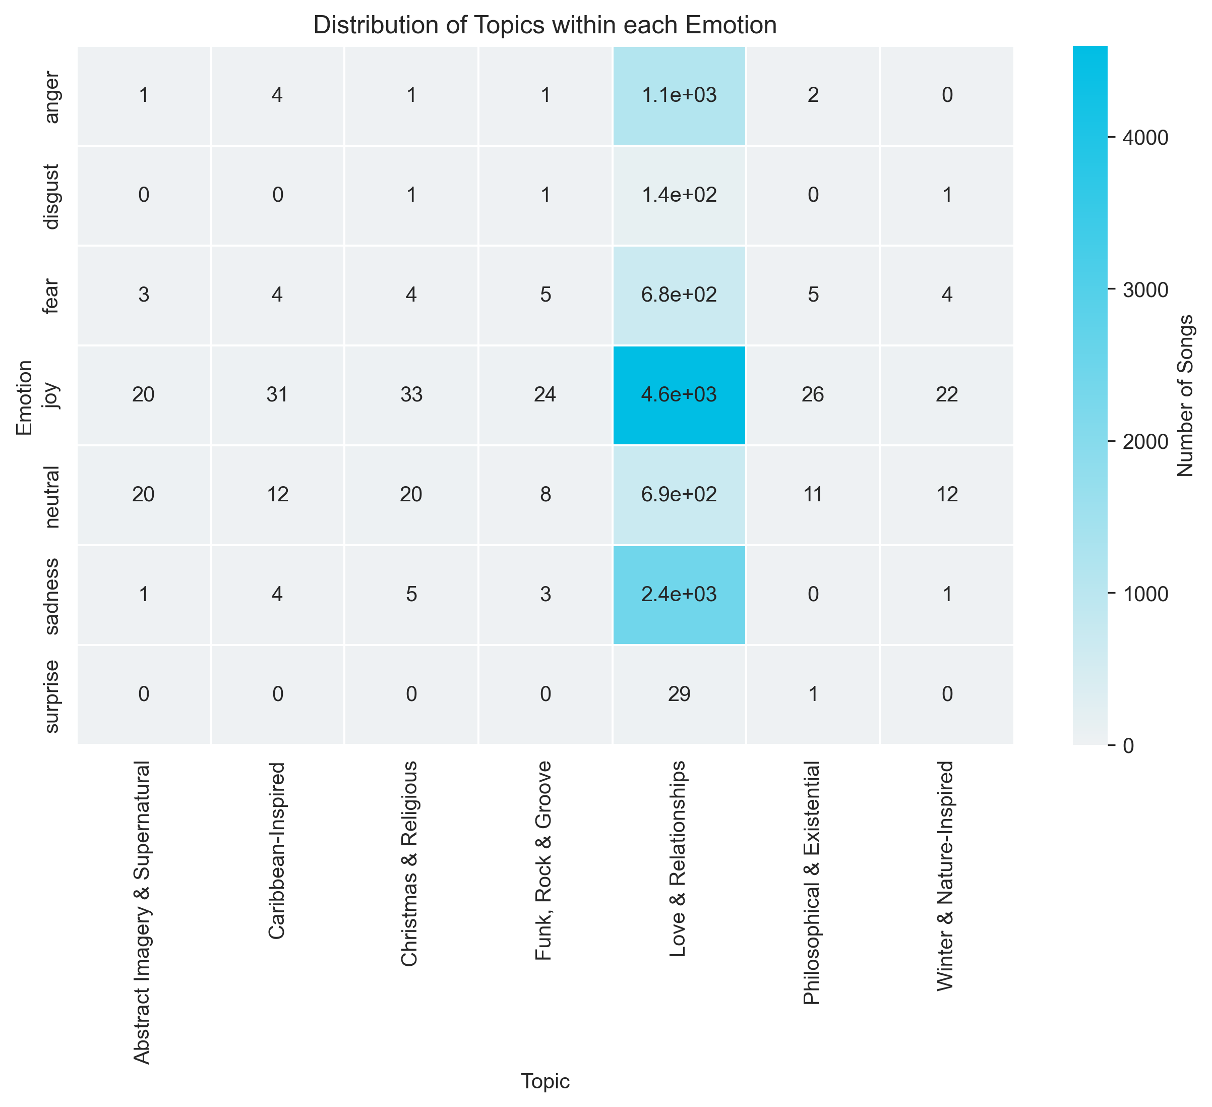
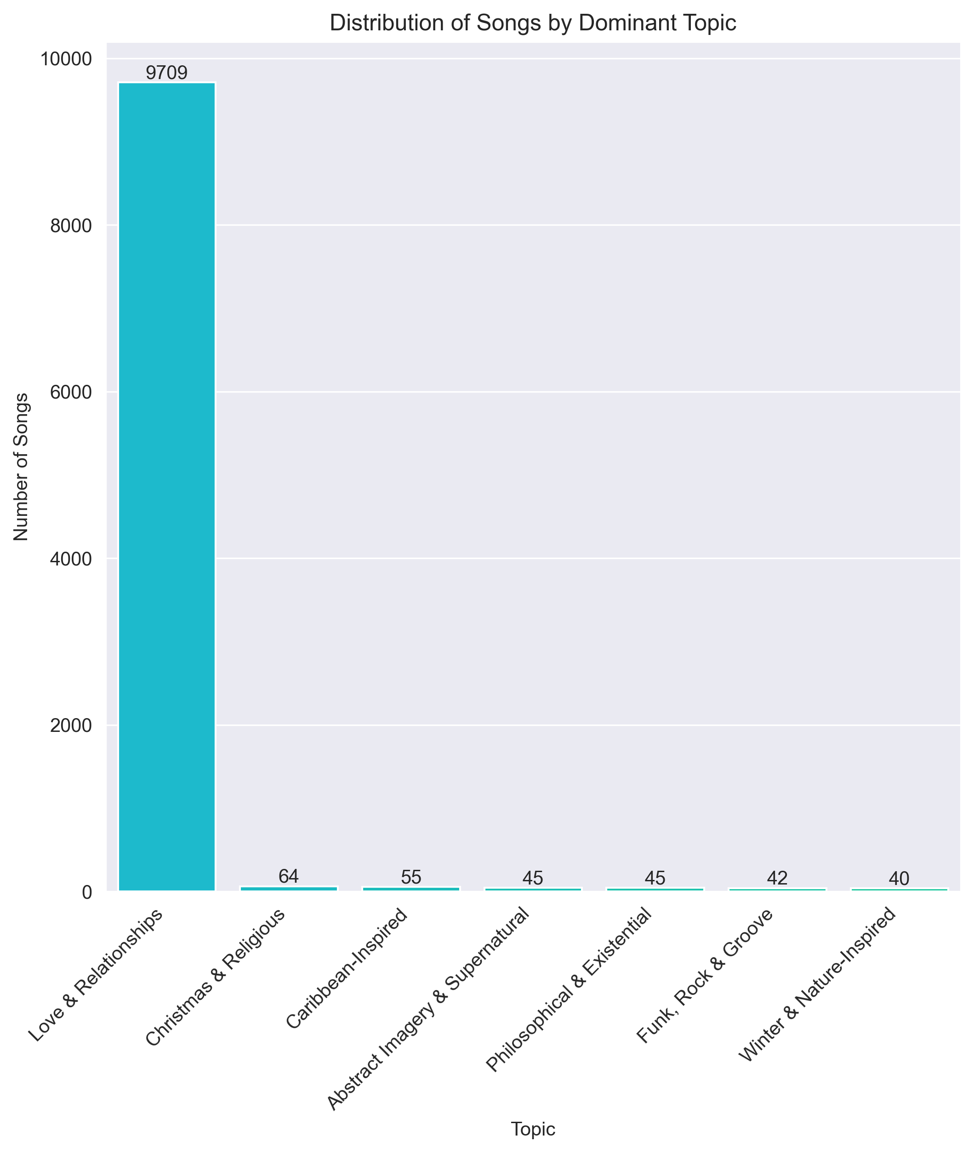
3. Topic Modelling
Purpose
Method and Results
Demonstration
Future Work
An overwhelming 97% of songs’ dominant topic is love & relationships.
46% of all songs belong to the joy and love & relationship categories.
Many combinations have 0 songs, and majority have less than 35 songs.
Unlikely to recommend good, personalised songs for those categories.
MoodTunes
Isabelle Rajendiran
Notes:
But what does the distribution of dominant topics i.e., the highest probability topic look like for my dataset.
This bar chart shows that an overwhelming 97% of my songs' dominant topic was love and relationships. This is a huge imbalance.
This imbalance was further highlighted by this heatmap which shows the spread of songs across both emotion and dominant topic. 46% of songs belong to the joy and love & relationship categories; and many reamining combinations having less than 35 and even 0 songs.
This has a severe negative impact on the users experience as there is essentially very little songs from which to recommend to the users fitting those categories.

Slide 11
3. Topic Modelling
Purpose
Method and Results
Demonstration
Future Work
Riding in the streets with no music sucks Everywhere I go, I cruise the streets being called an asshole Plus I'm being ridiculed and called a bum and called stupid
Chronic schizophrenia Chronic schizophrenia Chronic schizophrenia Chronic schizophrenia
…
- Chronic Schizophrenia by Wesley Willis
Predicted: Anger Christmas & Religious
MoodTunes
Isabelle Rajendiran
Notes:
To evaluate how well the dominant topic fits the lyrics, again, I randomly picked some songs and manually evaluated them. I found that the topics were generally not a very good fit for a lot of the songs, which I expected by the poor coherence of the topics and messy word clouds.
For example, this song is accurately an angry song but there is no indicator of Christmas or religion at all.

Slide 12
3. Similarity Matching
Purpose
Method and Results
Demonstration
Future Work
01
02
03
04
Compute cosine similarity
Get top 5 songs
Get user prompt
Filter dataset on emotion
Retrieve the top 5 songs with the highest similarity score.
Apply emotion classifier and LDA model on prompt.
Retrieve user emotion and topic distribution.
Only keep the songs matching the emotion of the user.
Calculate cosine similarity score between topic distributions of the prompt and every song.
MoodTunes
Isabelle Rajendiran
Notes:
Once, I had my complete dataset. I was now able to build a recommendation system.
How it works is I apply both models on the user prompt to get its main emotion and topic distribution.
Next, I filter the dataset to only contain songs with matching emotion to the user.
Then, I compute a cosine similarity score, a metric of similarity between two vectors, between the topic distribution of the prompt and every remaining songs’ topic distribution.
Then I display the top 5 songs with the highest similarity score.

Slide 13
Demonstration
Purpose
Method and Results
Demonstration
Future Work
Let’s see it in action!
Streamlit application
MoodTunes
Isabelle Rajendiran
Notes:
Prompt: I've loved every moment of this academy!

Slide 14

Purpose
Method and Results
Demonstration
Future Work
Future Work and Limitations
Get a more balanced dataset e.g., using genres to ensure variety.
Fine-tune the BERT model for lyrical emotion analysis.
Implement a multi-class system for emotion.
Improve the cleaning process for topic modelling, and try alternatives e.g., keyword matching.
MoodTunes
Isabelle Rajendiran
Notes:
To improve this project, I have a few suggestions.
Firstly, my dataset was quite imbalanced perhaps due to the random sampling. Next time, I could add genre information and use this to ensure more variety.
Additionally, the emotion classification model has not been trained specifically for lyrics, which are generally longer and more complex than social media posts, and TV dialogues. Therefore, it would be nice to train my own model specifically for lyrics.
On a similar note, lyrics can also be more than one emotion e.g., a change of emotion through the song so a better approach would be to use multi-label classification.
Lastly, the topics extracted for my topic modelling did not fit well. In the future, I want to improve my text cleaning and try other methods like keyword matching. The implementation of a feedback system would also help to improve the recommendations.

Slide 15
Purpose
Method and Results
Demonstration
Future Work
Thank you for listening!
Any questions?
CREDITS: This presentation template was created by Slidesgo, and includes icons by Flatiicon and inforgraphics & images by Freepik.
MoodTunes
Isabelle Rajendiran

Slide 16
3. Topic Modelling
Purpose
Method and Results
Demonstration
Future Work
Lord Endow me Lord lord lord lord lord Endow me Lord... Endow me, endow me Endow me Lord lord lord lord... anybody want God to endow? Endow me... I promise if you let go and let God, He will endow you Lord... Yeaaaaaah
…
- Endow Me by Le'Andria Johnson
Predicted: Sad Christmas & Religious
Riding in the streets with no music sucks Everywhere I go, I cruise the streets being called an asshole Plus I'm being ridiculed and called a bum and called stupid
Chronic schizophrenia Chronic schizophrenia Chronic schizophrenia Chronic schizophrenia
…
- Chronic Schizophrenia by Wesley Willis
Predicted: Anger Christmas & Religious
MoodTunes
Isabelle Rajendiran
Notes:
To evaluate how well the dominant topic fits the lyrics, again, I randomly picked some songs and manually evaluated them. I found that the topics were generally not a very good fit for a lot of the songs
The first one is example of an accurate classification. It shows a sad song with a strong religious theme.
However, I found that the topics were generally not a very good fit for a lot of the songs, which can be known already from the poor coherence of the topics and messy word clouds. For example, this song is accurately an angry song but there is no indicator of Christmas or religion at all.

